Slide 1
Shell Bootcamp 2024 3 Reflections for Week 1
Jallipalli Lakshmi Susmitha Jayasri
Date : 30-Aug-2024

Slide 2

About Me
“I am not a person who just completes the task, I enjoy the process and grow through it”
Please share an image / visual that best represents you

Slide 3

My learnings from this week!

Slide 4
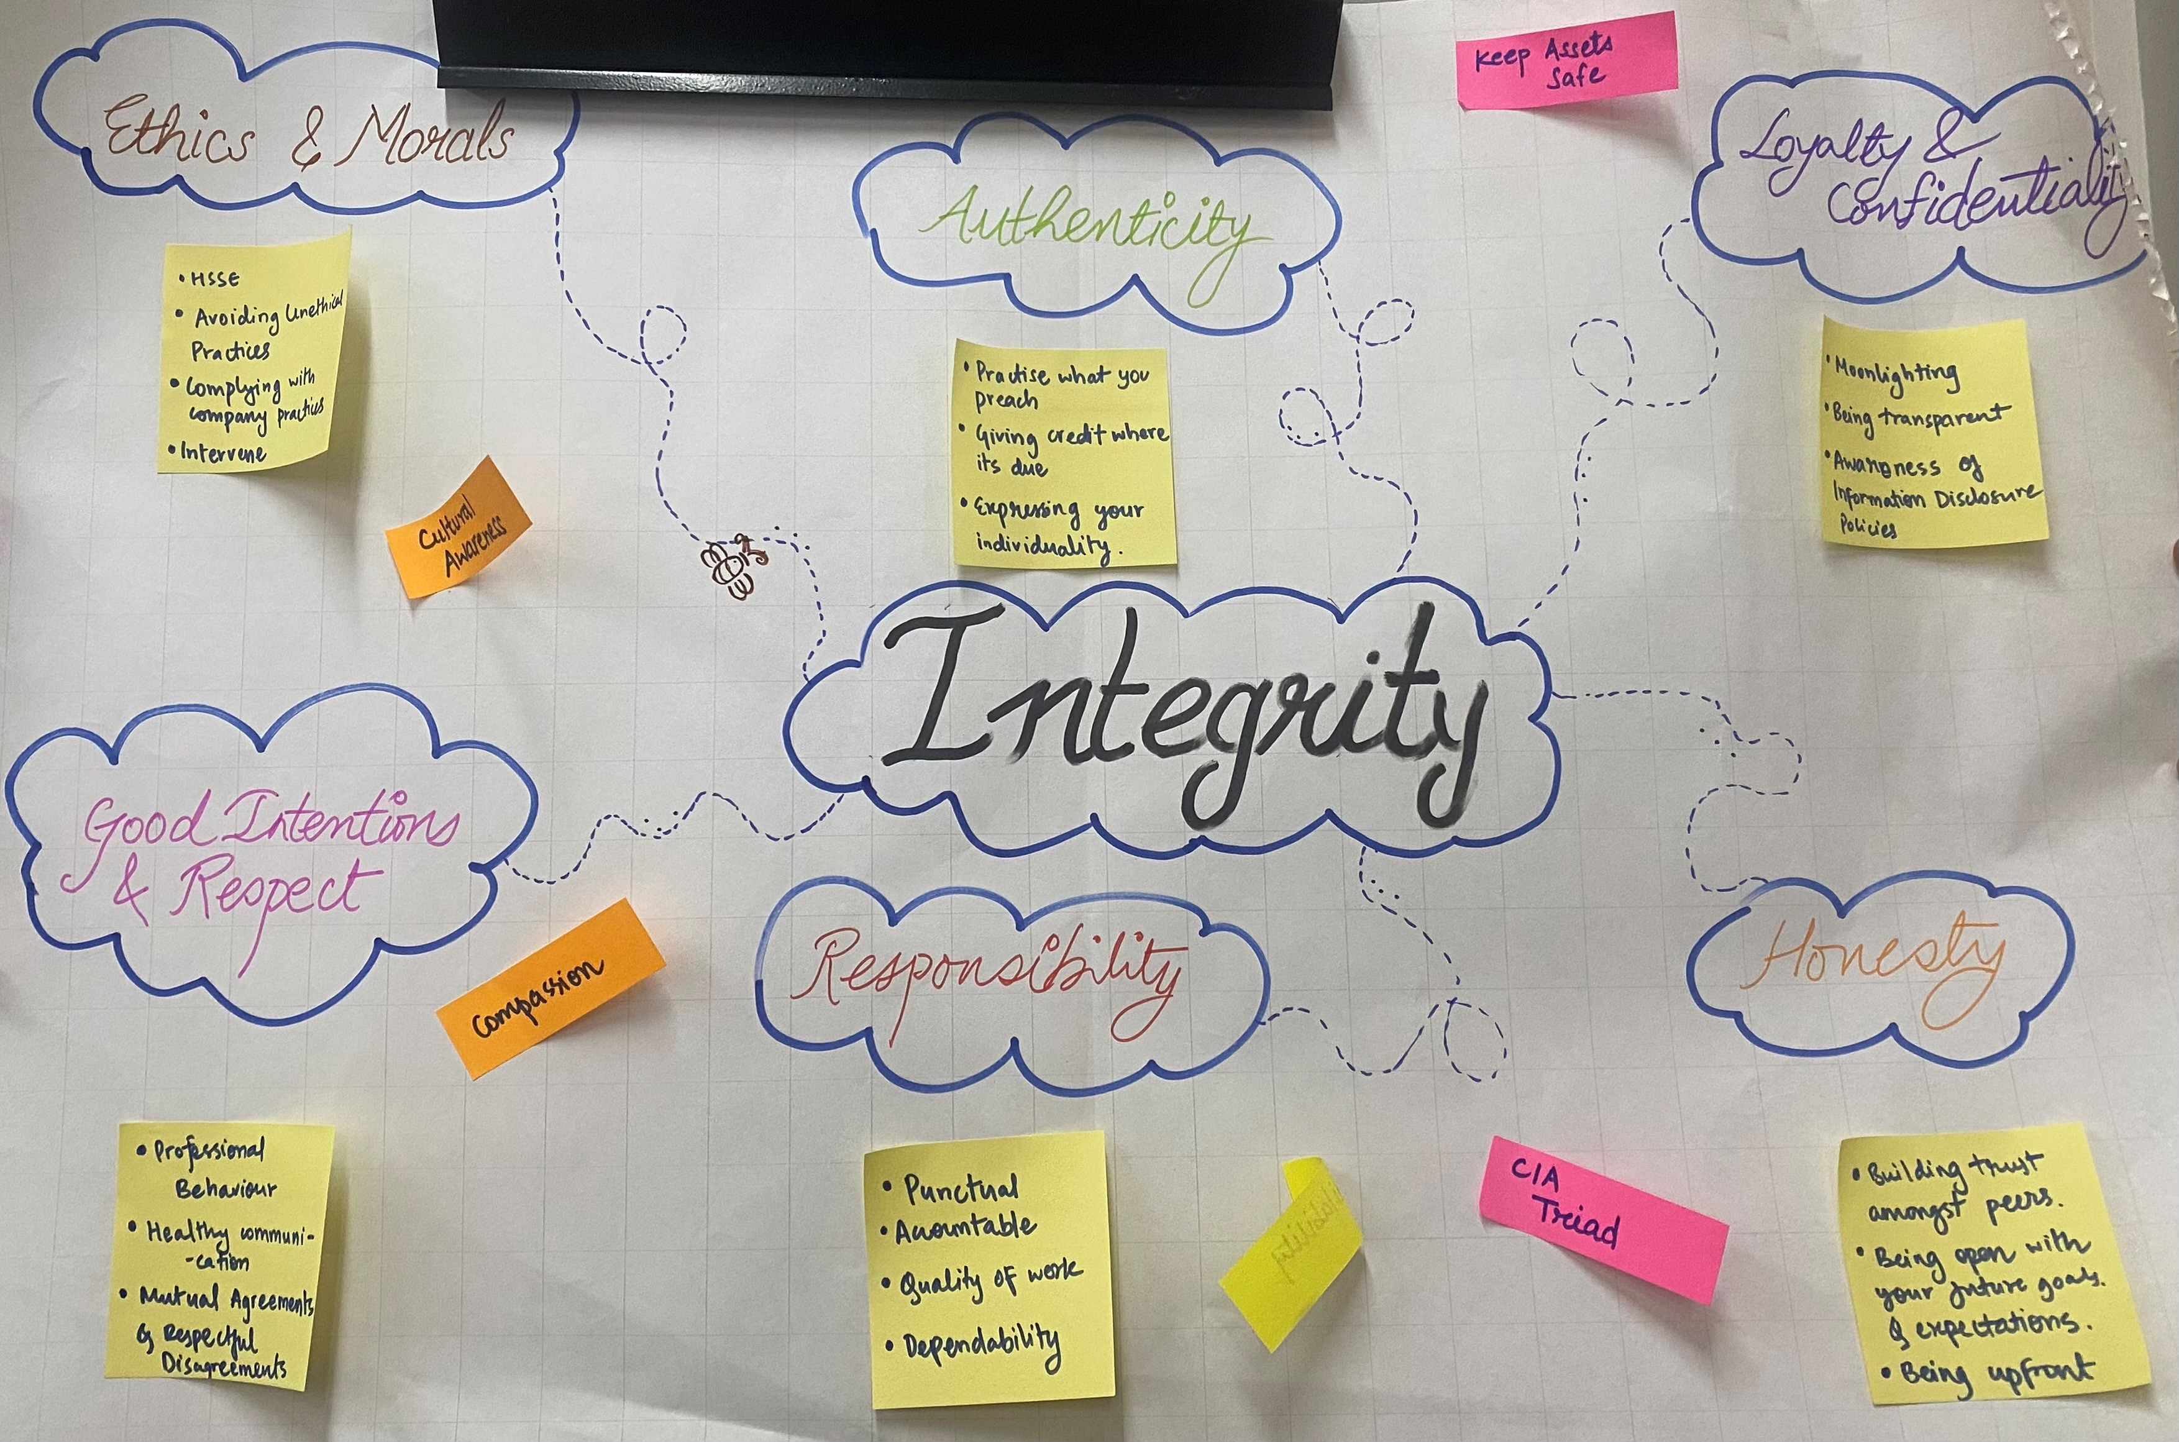
Learning 1 | My takeaways
Key Learnings: I have learned the importance of professionalism and its key attributes, including reliability, integrity and effective communication.
Key takeaways: No matter how well you perform, professionalism and integrity must be cultivated to ensure long term success and credibility.
Just like every other sector, professionalism is vital for ensuring reliable operations, upholding ethical standards, and fostering communication in energy sector. Integrity and strong professional image are essential for building trust with stakeholders and effectively managing industry complexities
[Add a graphic that provides evidence of what you learned]

Slide 5
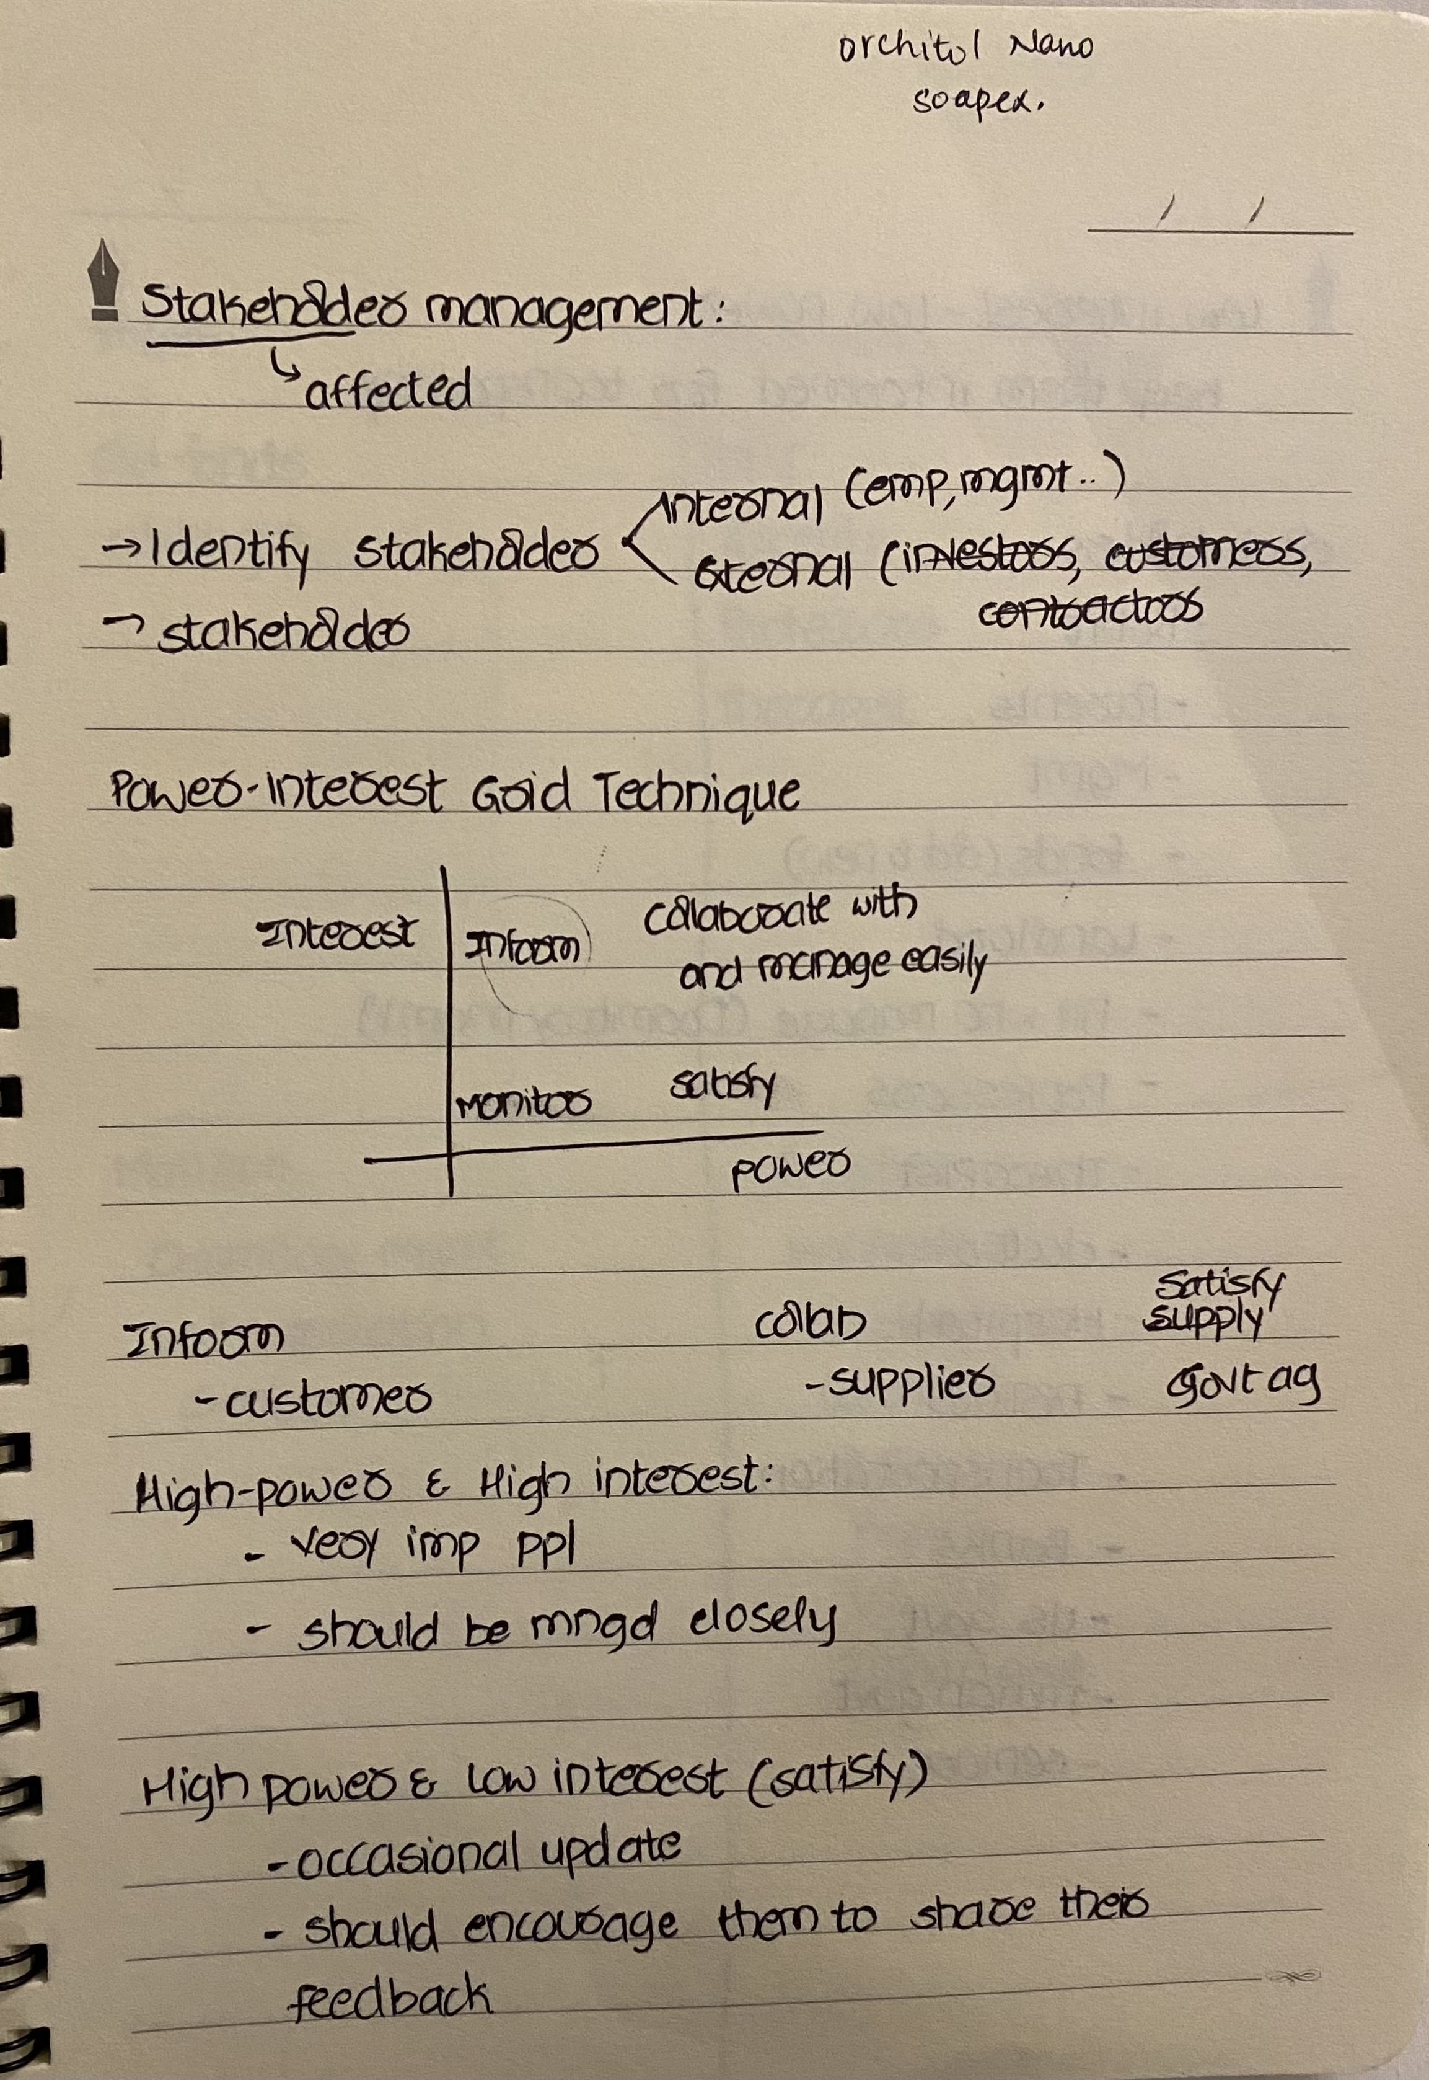
Learning 2 | My takeaways
Key learnings: I have learned how to manage stakeholders effectively and understood Shell’s trust model focused on credibility, reliability and intimacy.
Key takeaways: Trust is established through consistent communication and fulfilling commitments. Successful Stakeholder management involves understanding and addressing needs and interests of all the parties involved.
At Shell, trust is fostered through transparent operations and reliable communication. Stakeholder management involves actively engaging with diverse groups and aligning projects with their interests to ensure mutual success
[Add a graphic that provides evidence of what you learned]

Slide 6
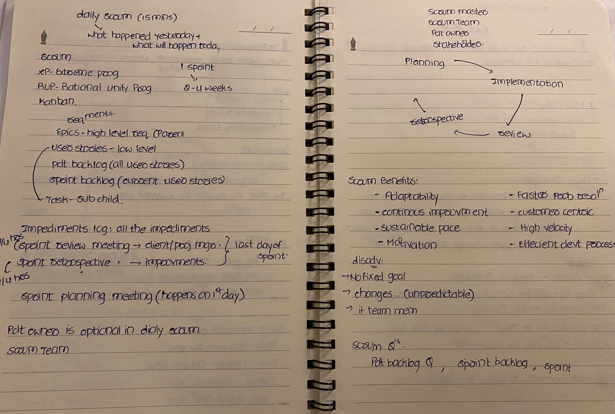
Learning 3 | My takeaways
Key learnings: I have learned how to leverage business analytics, manage requirements effectively, and apply Agile methodologies for flexible project requirement and how to implement Agile methodology in devops.
Key Takeaways: Business Analyst plays a key role in understanding requirements and plays a major role in project. Also never assume requirements, Just ask if you are not clear. Agile methodology is very efficient when compared to waterfall model since change is very constant in a project.
At Shell, business analytics improves drilling efficiency, and Agile methods enable rapid adaptation to industry changes and foster continuous improvement.
[Add a graphic that provides evidence of what you learned]

Slide 7

Relevance of learnings for my organization

Slide 8
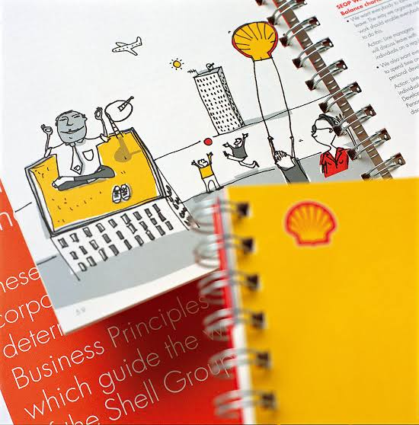
Learning 1 | Relevance for Shell
Shell implements professionalism through rigorous standards and high quality work, while effective communication is ensured through clear, consistent messaging and reporting across organization.
Shell benefits from professionalism and effective communication by building a strong reputation, fostering trust with stakeholders. This approach reduces miscommunications, enhances collaboration, and supports successful project outcomes
[Add a graphic that provides view of how Shell implements this learning]

Slide 9
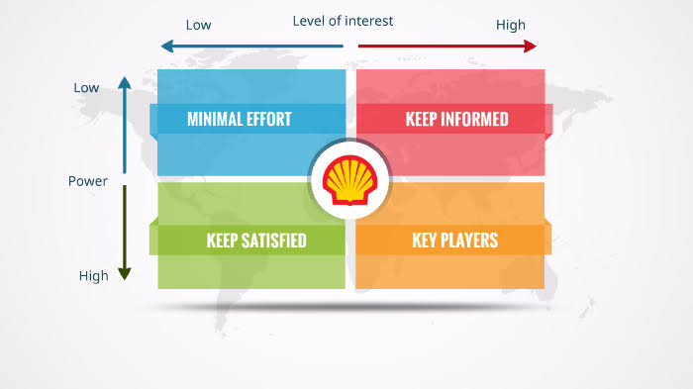
Learning 2 | Relevance for Shell
Shell implements stakeholder management by actively engaging with various groups, addressing their concerns and aligning projects with their interests. Trust is built through transparent operations, ethical practices, and consistent communication.
Shell benefits from effective stakeholder management and trust building by improving project support, reducing conflicts and enhancing its reputation.
[Add a graphic that provides view of how Shell implements this learning]

Slide 10
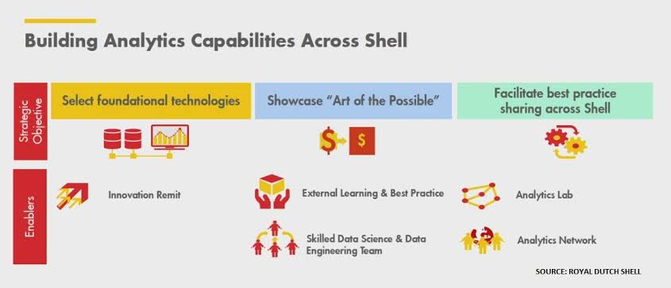
Learning 3 | Relevance for Shell
Shell uses business analytics to optimize operations and make data driven decisions. Agile methodology is applied to adapt quickly to changes and improve project efficiency.
These practices enhances operational efficiency, enable rapid adaptation to market changes, and drive innovation, leading to improves performance and competitive advantage.
[Add a graphic that provides view of how Shell implements this learning]

Slide 11

Challenges in implementing learning

Slide 12
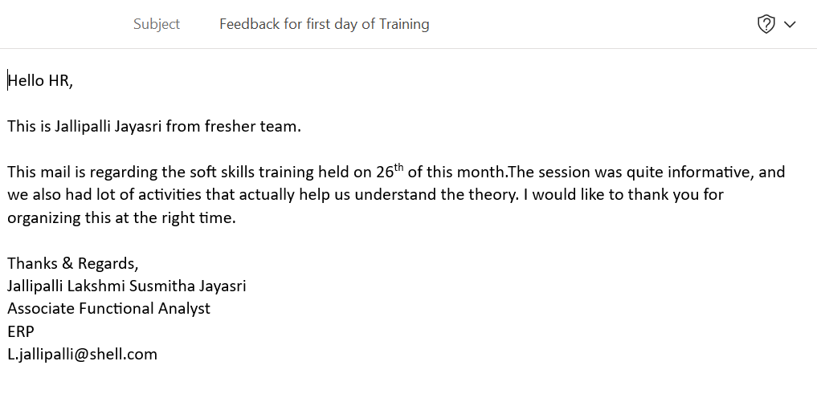
Challenge faced while implementing Learning 1
Challenge: Maintaining a professional image through etiquettes has been a challenge for me
Plan: Created several email drafts to help me familiarize myself with email etiquettes.

Slide 13
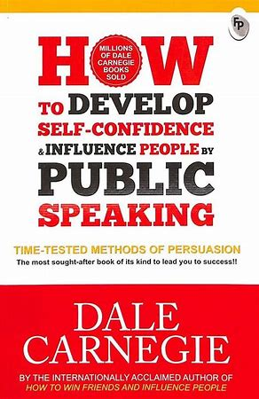
Challenge faced while implementing Learning 2
Challenge: I tend to struggle with communication which I believe could become an obstacle in the future when dealing with stakeholders.
Plan: I started reading the book “How to develop self confidence by public speaking?” by Dale Carnegie to enhance my communication skills.
[Add a graphic that provides evidence of what you did to overcome this challenge]

Slide 14
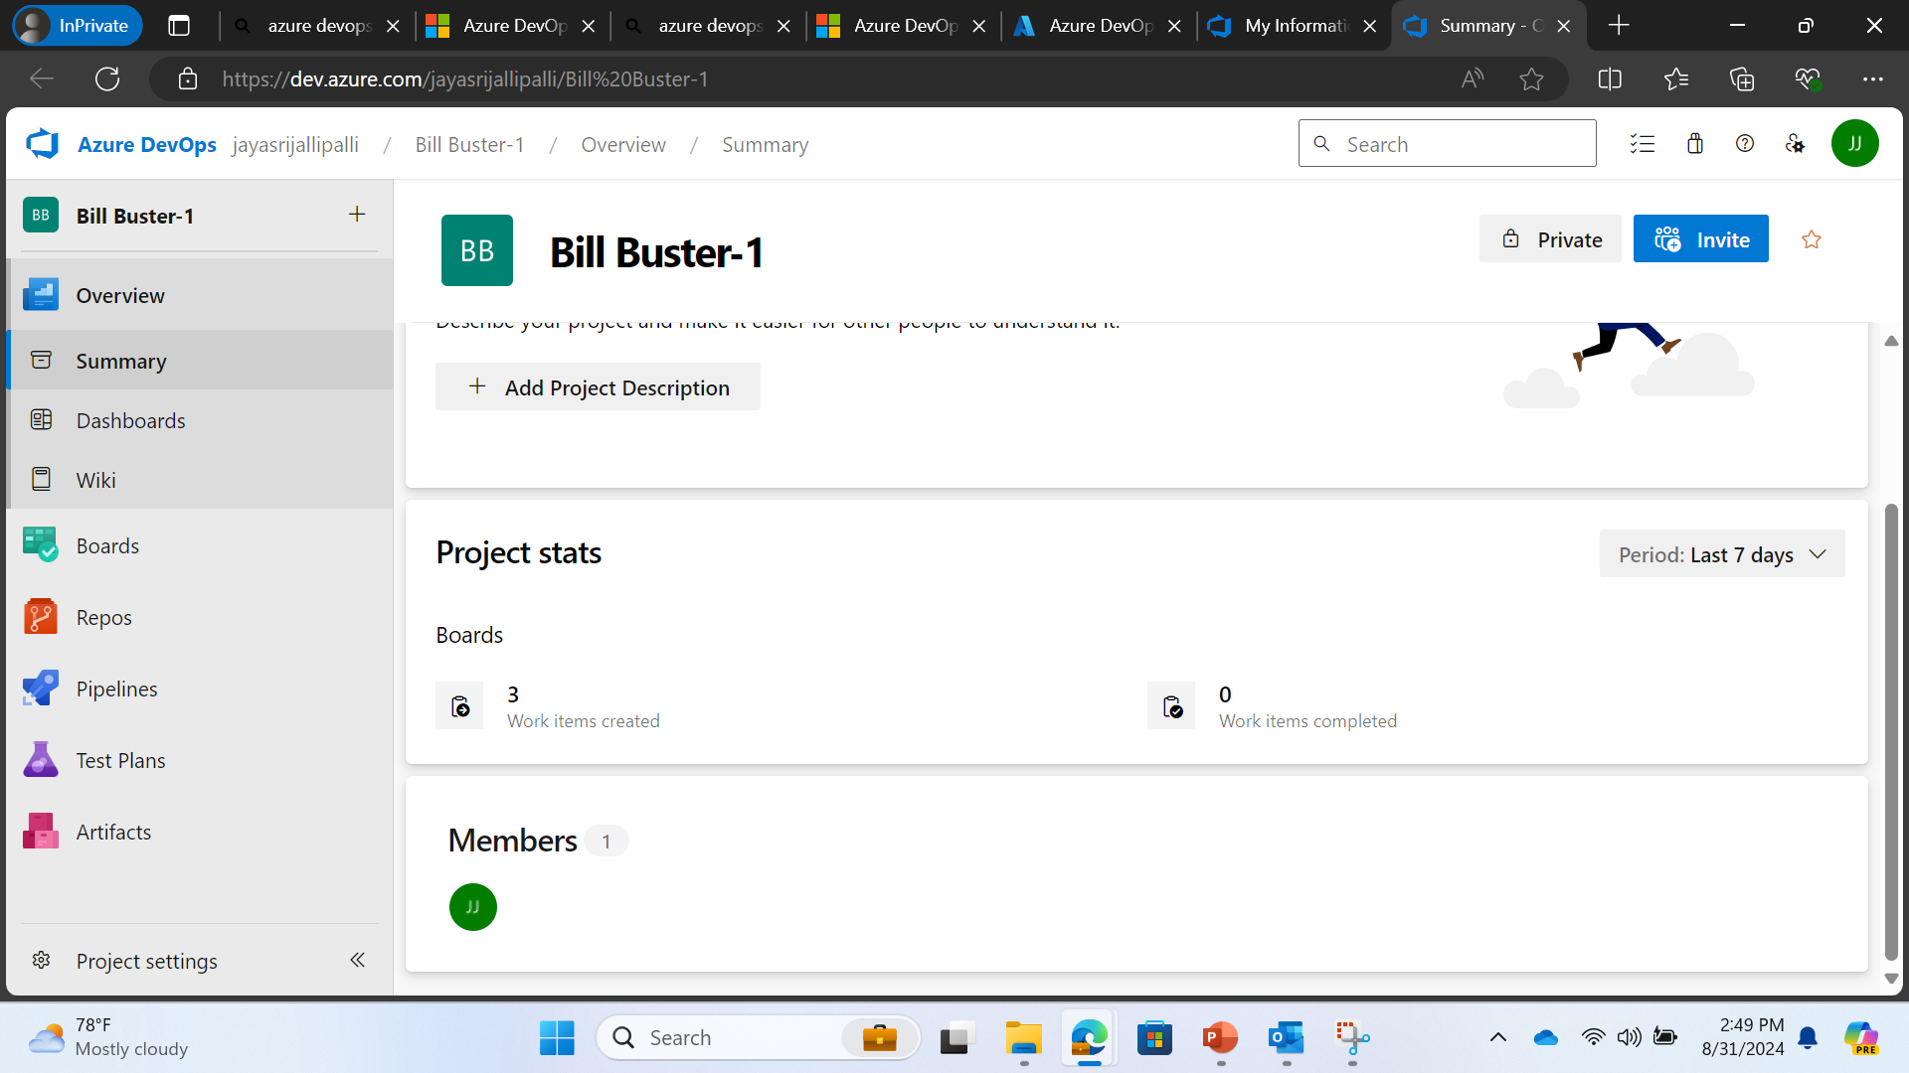
Challenge faced while implementing Learning 3
Challenge: I have difficulty in using Azure Devops as it is completely new website for me.
Plan: I kept exploring the Azure Devops in my free time so that I would be familiarized.
[Add a graphic that provides evidence of what you did to overcome this challenge]

Slide 15

Action Plan

Slide 16
My Action Plan for this Week
Actions
Timeline
Status
Practicing Email Etiquette
Reading book on how to build confidence
Using Azure Devops for familiarization
Interacting with my team
2 days for drafting and 1 day for review
Read for 30 minutes each day
Spend 20 minutes per day
Have to review the drafts
70% completed
Got myself familiarized
Met my LM and my buddy

Slide 17

Learning is also Fun!

Slide 18

Learning is also Fun!
My facilitator for soft skills training Mrs Padmashree has been very patient and made sessions very interactive and fun. We had many activities such as roleplays, making charts that helped me interact with everyone.
One of the group activity was to make a sentence with given words that was very fun because we came up with hilarious sentences and had a great time together.
[Add a graphic or a picture of how you/your team enjoyed the new learning]

Slide 19

Summary
Quick Summary:
Its not how much we work that matters; its how professionally we do it that counts
Never assume, Just ask if you are unclear about requirements
Importance of topics in upcoming week:
DBMS, Software testing, Devops and Cloud are the topics for next week.
Importance- As Shell is data driven company, DBMS and cloud plays a major role in managing the data.
Software testing ensures product quality which is crucial for delivering a high quality product.
Devops helps in accelerating delivery of product.
Connectivity of topics from current week:
Software testing is a phase in SDLC(Agile methodology) that is taught in this week. We can use Cloud for creating a environment for testing.

Slide 20
Thank You

